Slide 1

Artificial Intelligence Lecture 08: A* Search
Farhad Muhammad Riaz

Slide 2
A* Search
Idea: Avoid expanding paths that are already expensive
Evaluation function f(n) = g(n) + h(n)
g(n) = exact cost so far to reach n
h(n) = estimated cost to goal from n
f(n) = estimated total cost of cheapest path through n to goal
A* search uses an admissible heuristic:
h(n) ≤ h*(n) where h*(n) is the true cost from n
Also h(n) ≥ 0, and h(G)=0 for any goal G
E.g., h_{SLD}(n) is an admissible heuristic because it doesn’t overestimate the actual road distance

Slide 3
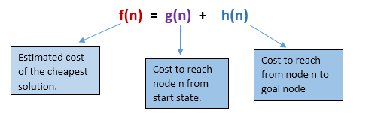
A* Search
If we are trying to find the cheapest solution, a reasonable thing to try first is the node with the lowest value of g(n) + h(n)
This strategy is more than just reasonable
Provided that h(n) satisfies certain conditions, A* using TREE search is both complete and optimal.

Slide 4
A* Search Algorithm
Step1: Place the starting node in the OPEN list.
Step 2: Check if the OPEN list is empty or not, if the list is empty then return failure and stops.
Step 3: Select the node from the OPEN list which has the smallest value of evaluation function (g+h), if node n is goal node then return success and stop, otherwise
Step 4: Expand node n and generate all of its successors, and put n into the closed list. For each successor n', check whether n' is already in the OPEN or CLOSED list, if not then compute evaluation function for n' and place into Open list.
Step 5: Else if node n' is already in OPEN and CLOSED, then it should be attached to the back pointer which reflects the lowest g(n') value.
Step 6: Return to Step 2.

Slide 5
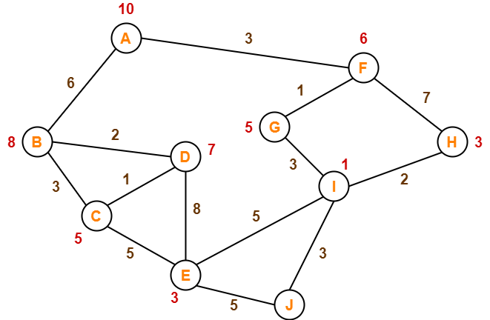
Example

Slide 6
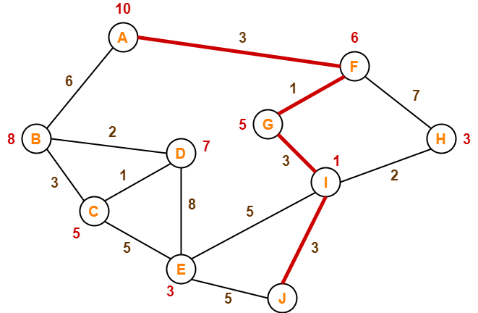
Example

Slide 7
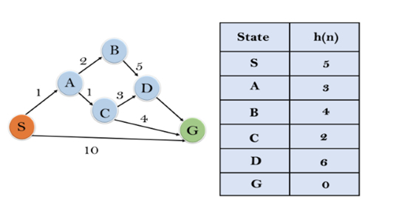
Example

Slide 8
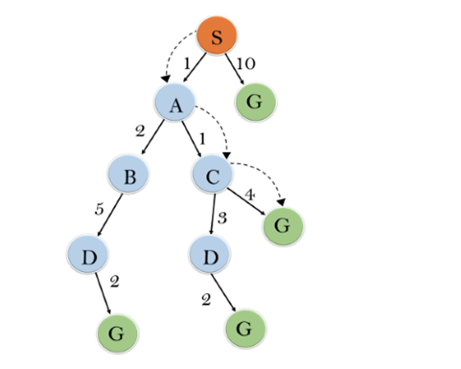
Example

Slide 9
Properties of A*
Complete? Yes (unless there are infinitely many nodes with f ≤ f(G) )
Time? Exponential
Space? Keeps all nodes in memory
Optimal? Yes

Slide 10
Admissibility of A* Algorithm
Condations
h(n) ≤ h*(n) ∴ Underestimation h(n) ≥ h*(n) ∴ Overestimation
h(n) Estimated Cost
h*(n) optimal Cost

Slide 11
Admissibility of A* Algorithm
Key Points:
The heuristic function h(n) is admissible if h(n) is never larger than h*(n) or if h(n) is always less or equal to the true value.
If A* employs an admissible heuristic and h(goal)=0, then we can argue that A* is admissible.
If the heuristic function is constantly tuned to be low with respect to the true cost, i.e.
h(n) ≤ h*(n), then you are going to get an optimal solution of 100%

Slide 12
Admissibility of A* Algorithm
Similar to the last situation, you are planning to buy a pair of shoes. This time, you estimate the shoe value to be $800. However, when you arrive at the store, the shopkeeper informs you that the shoes’ true price is $1000, which is higher than your estimate. indicating that you had understimated their value by $200. In this situation, Underestimation has occurred.
800 < 1000 i.e. h(n) ≤ h*(n) ∴ Underestimation
Let’s suppose, you are going to purchase shoes and shoes have a price of $1000. Before making the purchase, you estimated that the shoes will be worth $1200, When you went to the store, the shopkeeper informed you that the shoe’s actual price was $1, 000, which is less than your estimated value, indicating that you had overestimated their value by $200. so this is the case of Overestimation.
1200 > 1000 i.e. h(n) ≥ h*(n) ∴ Overestimation

